Slide 1
Blockchain: From Byzantine Generals to Distributed Trust
Dr. ir. Zhijie Ren
Cyber Security Group
Dep. Intelligent Systems
Delft University of Technology

Slide 2
Outline
What is blockchain?
Some stories
Basic concepts
Cryptographic Hash Function
Asymmetric Encryption
Digital Signature
Byzantine Fault Tolerance
What can block chain (not) do?
Challenges

Slide 3
Scope
Things that will be talked about:
What is blockchain?
Basic theories behind blockchain.
What can blockchain do?
What are the challenges in the research field?
Things that will not be talked about:
Details of Bitcoin.
Variants of blockchains.
Applications.

Slide 4
What is Blockchain?

Slide 5
What is Blockchain?
Blockchain = Bitcoin?
Blockchain = Proof-of-Work?
Blockchain = Distributed Database?

Slide 6
What is Blockchain?
Blockchain = Bitcoin?
Blockchain = Proof-of-Work?
Blockchain = Distributed Database?
Blockchain:
Distributed system
Tamper-proof data structure
Consensus protocol

Slide 7
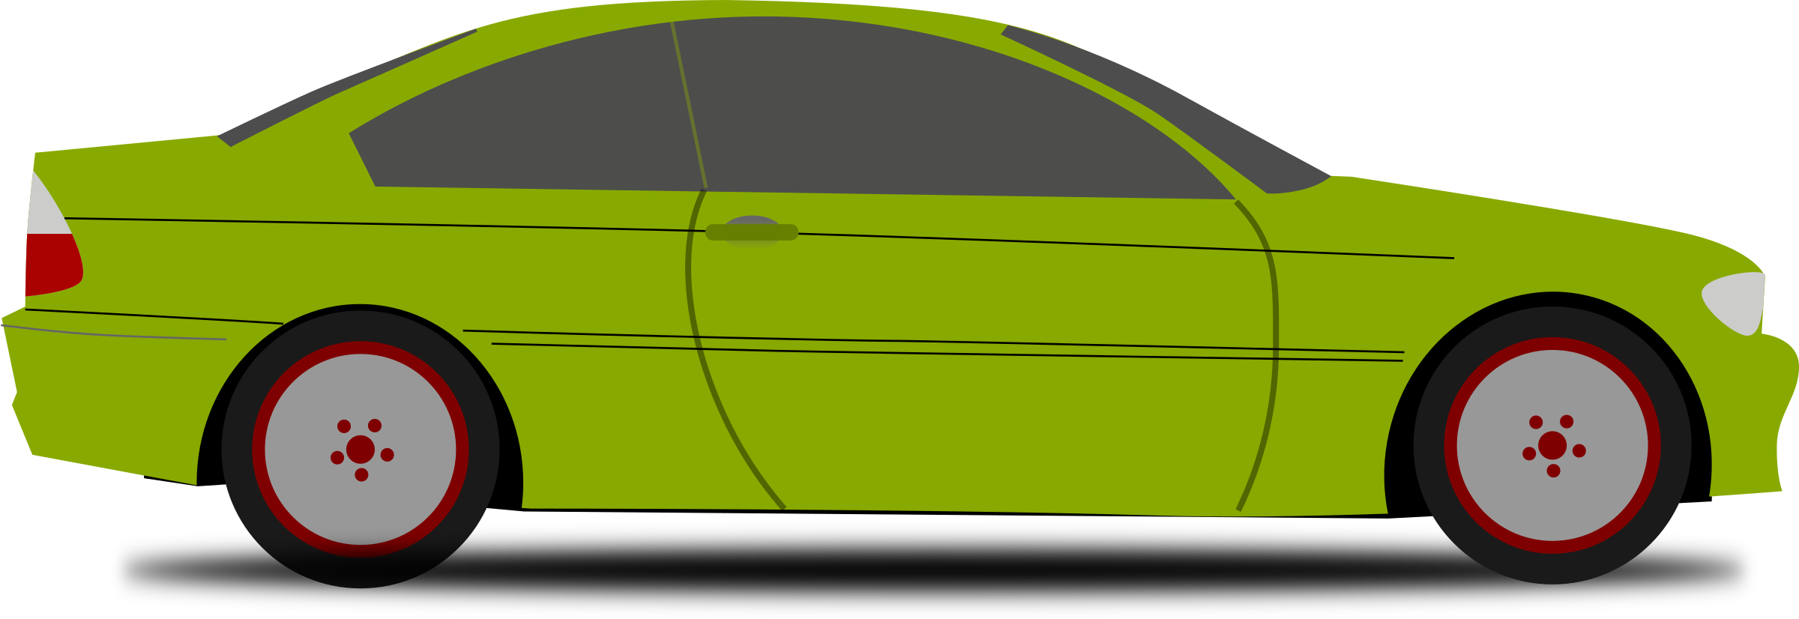

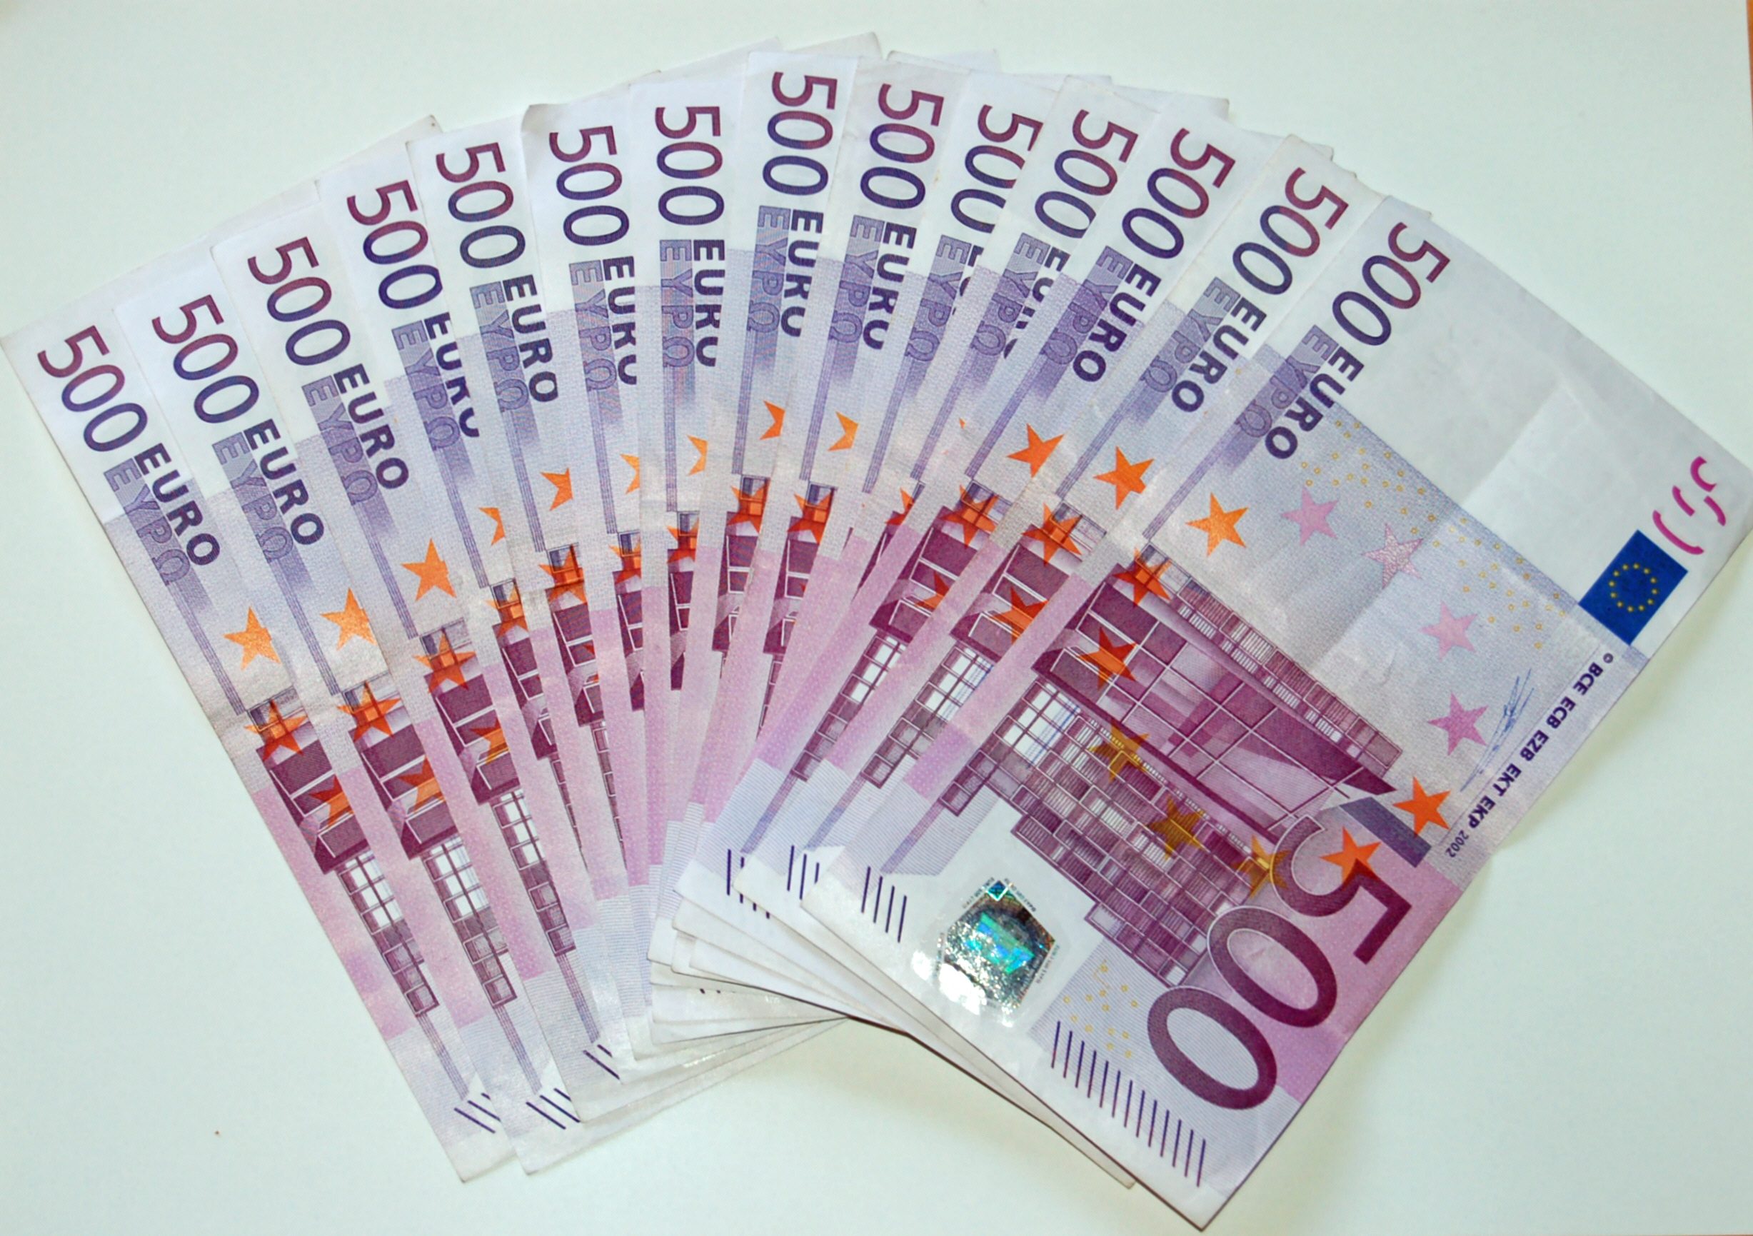
How does money work in digital world?
Alice
Bob

Slide 8

How does money work in digital world?
Digital “Cash”?
Alice
Bob

Slide 9
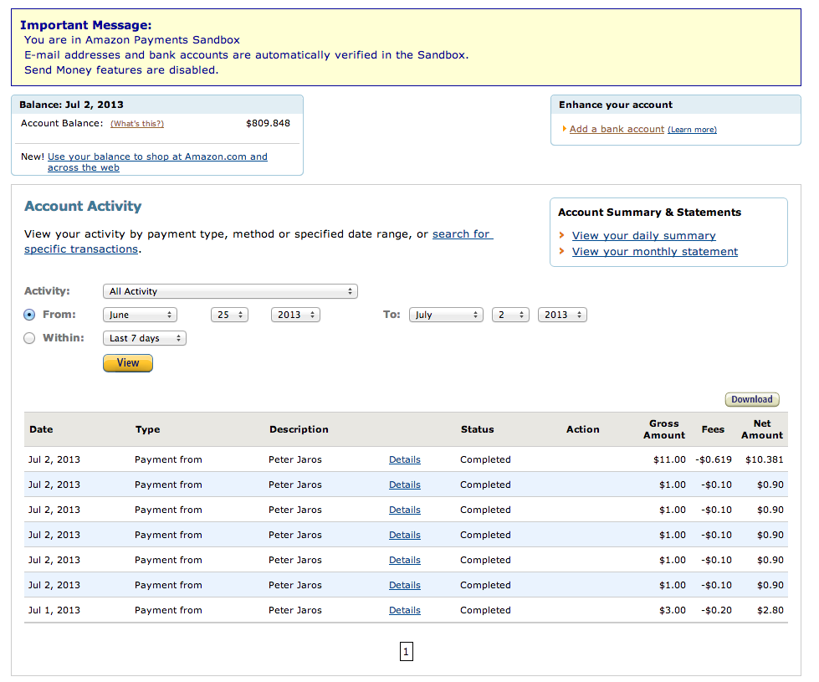
How does money work in digital world?
Digital “Cash”?
Account balance?
Alice
Bob

Slide 10
How does money work in digital world?
Digital “Cash”?
Account balance?
Transactions?
Alice
Bob
Bob → Alice: 5000 Euros

Slide 11
How does money work in digital world?
Digital “Cash”?
Account balance?
Transactions?
Alice
Bob
Bob → Alice: 5000 Euros
(Signature of Bob)

Slide 12
How does money work in digital world?
Digital “Cash”?
Account balance?
Transactions?
Alice
Bob
Bob → Alice: 5000 Euros
(Signature of Bob)
(Source:tx#18ab9e1…..)

Slide 13
How does money work in digital world?
GoofyCoin – Cryptocurrency with public-private key for transaction.
Double Spending
ScroogeCoin – “Blockchain” and Scrooge is used to prevent double spending.
Centralized
Bitcoin – Double spending solved by a decentralized consensus scheme (proof-of-work)

Slide 14
What is Blockchain?
Distributed system
Backbone.
Tamper-proof data structure
Tools: cryptographic hash function, asymmetric encryption, digital signature.
Provides: Authentication, integrity, tamper-prove.
Consensus protocol
Prevent double spending

Slide 15
What can blockchain do?

Slide 16


What does Uber or airbnb do?
3rd Party

Slide 17
What does Uber or airbnb do?
3rd Party
Reliable Rating
Secure Payment
Guarantee
Accessible Platform

Slide 18
What does Uber or airbnb do?
3rd Party
Reliable Rating
Secure Payment
Guarantee
Accessible Platform
Blockchain
Distributed System
Tamper-Proof Data Structure
Consensus Protocol

Slide 19
What does Uber or airbnb do?
3rd Party
Reliable Rating
Secure Payment
Guarantee
Accessible Platform
Blockchain
Distributed System
Tamper-Proof Data Structure
Consensus Protocol

Slide 20
Basic Concepts
Cryptographic Hash Function
Asymmetric Encryption
Digital Signature
Byzantine Fault Tolerance

Slide 21

Cryptographic Hash Function
Conceptually: A meat grinder.
Actually: A function Y=H(X).
Message
(Arbitrary size)
Hash
Digest
(Fixed size)

Slide 22
Cryptographic Hash Function
Properties of the hash function Y=H(X)
Given X, it is easy to compute H(X).
Given Y, it is impossible to find X.
Given H(X1)=Y, it is impossible to find X2 such that H(X2)=Y.
Given X1 and X2 that are only differ in 1 bit, H(X1) and H(X2) looks completely different.
Widely used for integrity check.

Slide 23
Cryptographic Hash Function
Some famous hashes:
MD5 (broken)
SHA (Secure Hash Algorithm) family
SHA-1 (broken)
SHA-2 (SHA-224, SHA-256, SHA-384, SHA-512, SHA-512/224, SHA-512/256.)
SHA-3 (faster)

Slide 24


Asymmetric Encryption
Symmetric Encryption
Asymmetric Encryption
Plaintext
Enc.
Cyphertext
Dec.
Plaintext
Key
Key
Plaintext
Enc.
Cyphertext
Dec.
Plaintext
Public
(Private)
Key
Private
(Public)
Key

Slide 25
Asymmetric Encryption
Some famous schemes:
Diffie-Hellman Key Exchange (discrete logarithm problem)
RSA (factoring problem)
ECC (elliptic curve discrete logarithm problem)
Applications:
Confidentiality (mostly encryption of the session key)
Authentication

Slide 26
Digital Signature
A message is received from an insecure channel
Authentication
Integrity
Non-repudiation
M
M’

Slide 27
Digital Signature
A message is received from an insecure channel
Tools:
Hash function: Y=H(X)
Encryption with private key: Y=E(X)
M
E[H(M)]
M’
E[H(M)]

Slide 28
Digital Signature
A message is received from an insecure channel
Receiver:
Decrypt with the public key: D{E[H(M)]}=H(M)
Hash the message: H(M’)
Compare the two results.
M
E[H(M)]
M’
E[H(M)]

Slide 29
Digital Signature
A message is received from an insecure channel
H(M’)=D{E[H(M)]}
Authentication
Integrity
Non-repudiation
M
E[H(M)]
M’
E[H(M)]

Slide 30
Data Structure of Blockchain
H
(B1)
H
(B2)
H
(B3)
B1
B2
B3
B4
Trans.1 E[H(Trans.1)
Trans.2 E[H(Trans.2)
Trans.3 E[H(Trans.3)
Trans.4 E[H(Trans.4)
⁞
Genesis Block

Slide 31
Break
What is blockchain?
Some stories
Basic concepts
Cryptographic Hash Function
Asymmetric Encryption
Digital Signature
Byzantine Fault Tolerance
What can block chain (not) do?
Challenges

Slide 32
Byzantine Generals Problem
Firstly stated in 1982 by L. Lamport et. al, “The Byzantine Generals Problem”.
N Byzantine generals want to reach agreement on when to attack an enemy city.
They can only communicate by sending out messengers.
Some of the generals might be traitors. They can do anything to prevent the agreement.
N byzantine generals want to reach agreement.
= N nodes want to have some consensus.
= N parties establish trust.

Slide 33
3 Generals Problem
The 3 generals problem:
3 generals, 1 commander and 2 lieutenants.
1 of them is a traitor (don’t know which one).
2 honest parties want to reach agreement on “attack” or “retreat”.
More precisely – Conditions:
I, All loyal lieutenants reaches agreement.
II, If the commander is loyal, then the loyal lieutenant(s) obey his order.

Slide 34
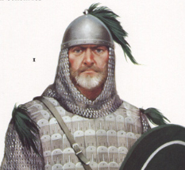

3 Generals Problem – Case 1

Slide 35
3 Generals Problem – Case 1
0
0

Slide 36
3 Generals Problem – Case 1
0
0
0
1

Slide 37
3 Generals Problem – Case 2
0
1

Slide 38
3 Generals Problem – Case 2
0
1
0
1

Slide 39
Byzantine Fault Tolerance
Questions:
Signed messages?

Slide 40
3 Generals Problem – Signed Messages
A
A:0
A:1
B
C
B:(A:0)
C:(A:1)

Slide 41
Byzantine Fault Tolerance
Questions:
Signed messages? (tolerant N-2 traitors)

Slide 42
Byzantine Fault Tolerance
Questions:
Signed messages? (tolerant N-2 traitors)
Asynchronous?

Slide 43
Asynchronous Byzantine Generals Problem
Conditions:
I, All loyal lieutenants reaches agreement.
II, If the commander is loyal, then the loyal lieutenant(s) obey his order.
III, The decisions should be made before time t.

Slide 44
3 Generals Problem – Case 1 (Asynchronous)
Faulty commander sends nothing at all.

Slide 45
3 Generals Problem – Case 1 (Asynchronous)
Faulty commander sends nothing at all.
To satisfy the termination condition, two lieutenants must decide after a period of t.
0
0

Slide 46
3 Generals Problem – Case 2 (Asynchronous)
1
1
The message has a delay T>t.

Slide 47
Byzantine Fault Tolerance
Questions:
Signed messages? (tolerant N-2 traitors)
Asynchronous? (no solution)

Slide 48
Asynchronous Byzantine Generals Problem
Conditions:
I, All loyal lieutenants reaches agreement.
II, If the commander is loyal, then the loyal lieutenant(s) obey his order.
III, (Weak termination) The decisions should be made before time t if the commander is not faulty. (If the commander is faulty, then either some decision is made or no decision is made are both valid)

Slide 49
3 Generals Problem – Case 1 (Asynchronous, Weak Termination)
A
0
0
Faulty lieutenant sends nothing. Honest generals decides 0.
To meet the conditions, A and B must decide 0 at some time t1.
B
C

Slide 50
3 Generals Problem – Case 2 (Asynchronous, Weak Termination)
A
0
1
In this case, B have to decide 0 at t1.
B
C
1, delayed T

Slide 51
3 Generals Problem – Case 2 (Asynchronous, Weak Termination)
A
0
1
In this case, B have to decide 0 at t1.
Similarly, C decides 1 at t2.
0, delayed T>max(t1,t2)
B
C
1, delayed T>max(t1,t2)

Slide 52
Byzantine Fault Tolerance
Questions:
Signed messages? (tolerant N-2 traitors)
Asynchronous? (no solution)
Asynchronous with weak termination? (tolerant less than N/3) traitors.

Slide 53
Byzantine Fault Tolerance
Questions:
Signed messages? (tolerant N-2 traitors)
Asynchronous? (no solution)
Asynchronous with weak termination? (tolerant less than N/3) traitors.
Basic idea: N-f≥2f+1

Slide 54
Byzantine Fault Tolerance
Questions:
Signed messages? (tolerant N-2 traitors)
Asynchronous? (no solution)
Asynchronous with weak termination? (tolerant less than N/3) traitors.
Basic idea: N-f≥2f+1
BGP = BFT?
Yes (Synchronous)
No, might need many iterations of BGP algorithms (Asynchronous)

Slide 55
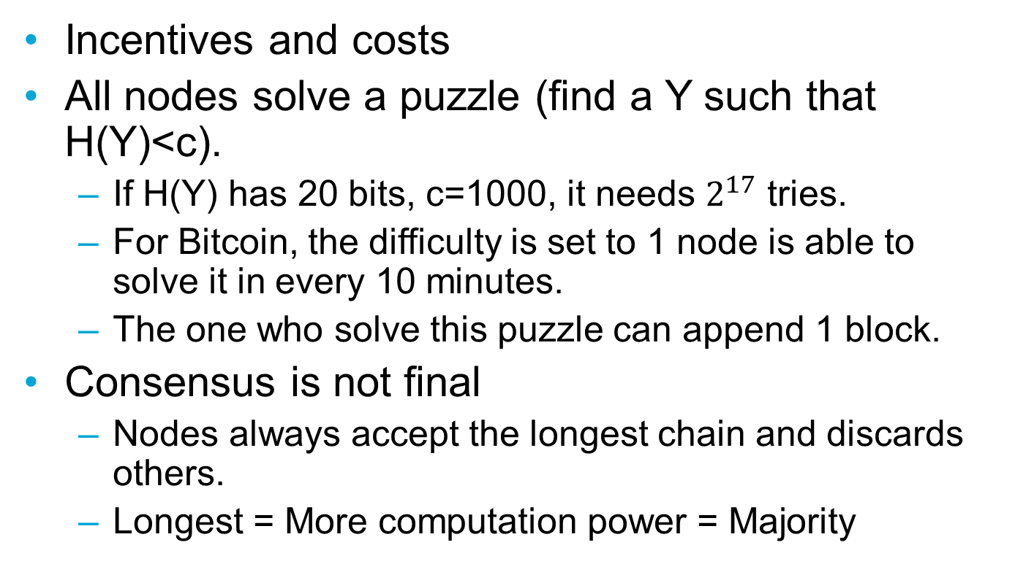
Proof-of-Work
Incentives and costs
All nodes solve a puzzle (find a Y such that H(Y)<c).
If H(Y) has 20 bits, c=1000, it needs $2^{17}$ tries.
For Bitcoin, the difficulty is set to 1 node is able to solve it in every 10 minutes.
The one who solve this puzzle can append 1 block.
Consensus is not final
Nodes always accept the longest chain and discards others.
Longest = More computation power = Majority

Slide 56
Proof-of-Stake
Still POW, but the difficulty of the puzzle depends on the amount of money you have.
More money = Easier puzzle.
PROS:
Less energy consumption.
More protection to majority attack.
CONS:
There must be a stake.
Nothing-at-stake attack.

Slide 57
BFT algorithms vs. POW
BFT algorithms: permissioned, small set of nodes, high performance, provable BFT, final consensus, tolerant <N/3 adversaries, not scalable.
POW: permissionless, thousands of nodes, low performance, not provable BFT, no final consensus, tolerant adversaries with ¼ computational power, energy consuming.

Slide 58
What can blockchain do?

Slide 59
What can blockchain do?
Decentralization (What can we decentralize?)
Existing centralization:
Central authority: cryptocurrency
3rd parties: Airbnb, Uber
No centralization, but require trust:
Consortiums
Enable new applications:
Smart contract

Slide 60
What can blockchain not do?
Central control is inevitable.
Collecting data for deep learning.
No trust/byzantine node issue.
Sensors in a secure environment.
No secure infrastructure.
Don’t need agreement.
Variant house-holding devices.
Things that beyond blockchain’s capability.

Slide 61
How good is blockchain?
Throughput
Public blockchains:
Bitcoin (1MB/10min or 7 tx/sec)
Ethereum (15 tx/sec, increasing)
Trade-off between performance and number of nodes.
Latency
Security
Majority attack (POW)/ Nothing-at-stake attack (POS)/ Sybil attack (BFT)
Privacy
Management
Hard forking
Side effects
Energy consumption of mining.

Slide 62
Challenges
Improve the throughput
Improve the throughput of POW and POS (restricted by transmission speed)
Improve the scalability of BFT protocols
Enhance the security and privacy
Enable more applications
Build an applicable blockchain for industry

Slide 63

Thank you!
Questions?

